Slide 1
Real-life CSI??? (kinda)
Forensics in CTFs:
Slides by Miguel for CyberSoc’s CTF Cafe

Slide 2
What is
Forensics?
Forensics is a CTF category which revolves around examining hidden data in an otherwise innocuous static file. Forensics in CTFs is pretty dissimilar to real world forensics tasks, but the tools and techniques used are very much applicable!

Slide 3
What makes a good Forensics Challenge solver?
Observation Skills
Research Ability
Understanding Toolkits
Opt: Programming
Spotting patterns, anomalies etc.
Knowing file formats, typical protocols etc.
Tools are your best friend in forensics and help parse unreadable information
Scripting languages are useful for harder tasks…

Slide 4
Types of Forensic Challenge
01
02
File Analysis
Steganography
03
04
Memory Analysis
Network Analysis
You can describe the topic of the section here
Files hidden in files hidden in files hidden in files hidd-
Examining disk images, live memory dumps and more!
Looking into network traffic through packet captures.

Slide 5
01
File Analysis
Let’s jump into how to analyse files in Forensics challenges!

Slide 6
Challenge Structure
File analysis challenges provide you with a file which contains or leads to the flag in some way.
Identifying a file format and manipulating accordingly
Fixing a broken or corrupted file
Analysing metadata or patterns in file hex
In harder cases: scripting to manipulate binary data

Slide 7
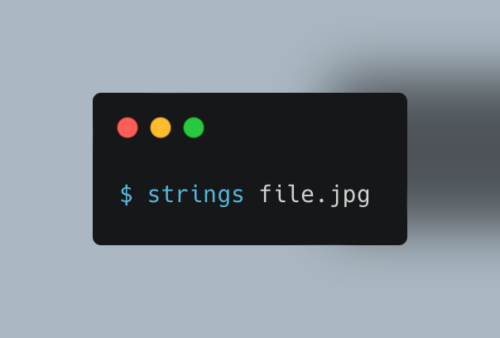
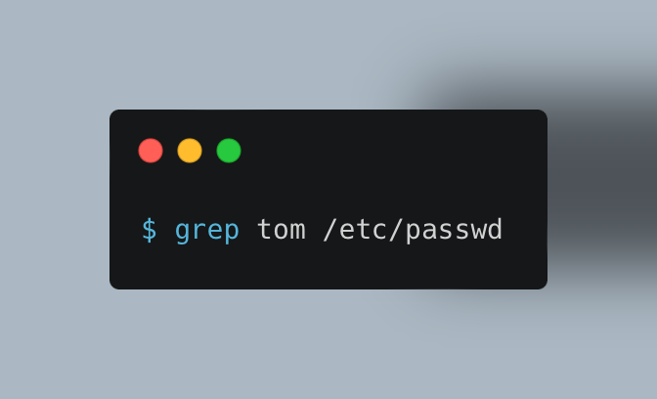
Initial Analysis
Command line utilities are a great first step when analysing files.
Strings prints out all plaintext strings in a file.
Grep searches for a specified string in a given file.
You can also use bgrep to find non-text patterns!

Slide 8
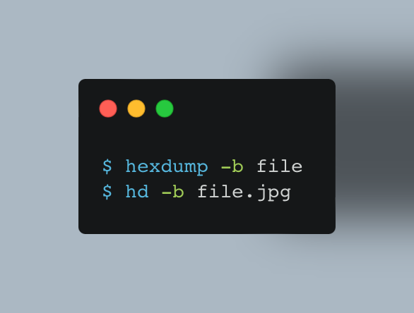
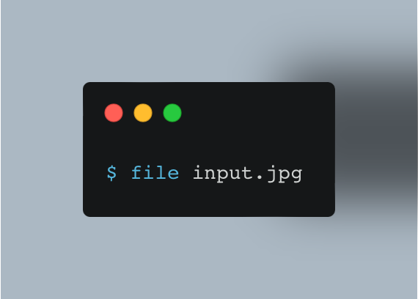
Initial Analysis cont.
Hexdump will display the content of a file in hex – this is useful for spotting patterns or anomalies.
Sometimes a file isn’t what you think it is… use file to check what its file signature indicates.

Slide 9
Common File Formats
Archive files (ZIP, TGZ)
Image file formats (JPG, GIF, BMP, PNG)
Filesystem images (especially EXT4)
Packet captures (PCAP, PCAPNG)
PDF
Video (especially MP4) or Audio (especially WAV, MP3)
Microsoft’s Office formats (RTF, OLE, OOXML)
Source: https://www.csc.ac.za/?page_id=249
Never seen a file type before? The challenge is probably to do with finding an obscure tool/documentation set to learn how to handle it.

Slide 10
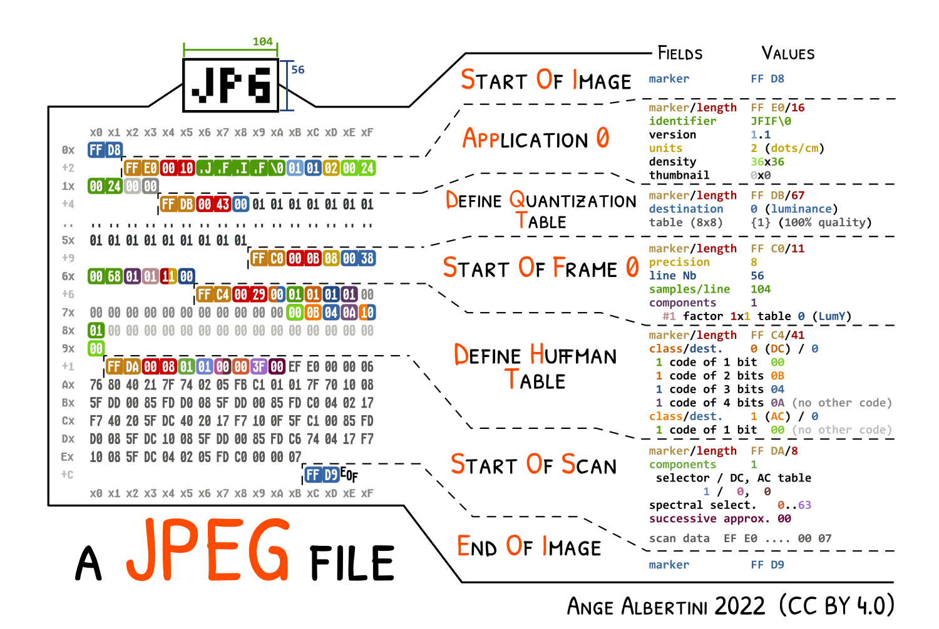

Slide 11
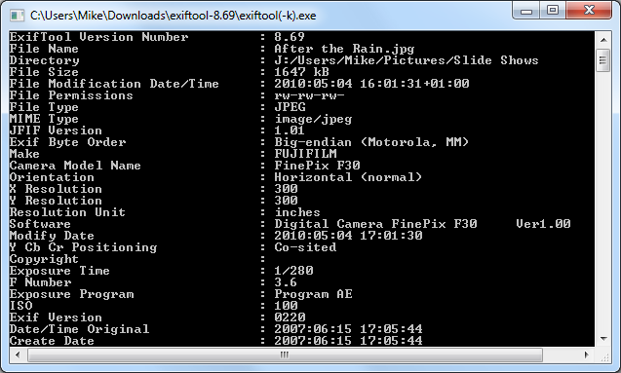
Speaking of files… what’s metadata?
Metadata is data that provides information on data – i.e. where an image was taken, what camera it was taken on etc.
Most files will have metadata, and whilst it isn’t always useful in a CTF, it’s worth taking a look for information.
The best tool for extracting and viewing metadata for a CTF is exiftool.

Slide 12
More on Image Files
Got a broken PNG? Try out pngcheck – a command line utility for checking what’s wrong with your images and helpfully identifying what you could fix to get it to open. http://libpng.org/pub/png/apps/pngcheck.html
Sometimes, image editing is useful – so crack out Photoshop or Gimp and play around with filters and various settings. You can get Gimp here: https://www.gimp.org/
Need to do more than just the basics? You can script your own image handling functions using PIL, the Python Image Library (now known as Pillow in newer versions). https://pypi.org/project/Pillow/

Slide 13
Analysing Archive Files
Archive files, such as 7z, rar, tar, gz, and more, are a huge part of CTF challenges!
Here are some important facts about them:
If you have a password-protected .zip, you can still view the file names and original filesizes of its contained files. This does not work on .rar or .7z!
Fcrackzip is a great tool for bruteforcing password-protected archive files.
There are plenty of command line utilities for checking zip file properties:
zipdetails –v prints detailed information on the file and its fields.
zipinfo lists information on the zip’s contents.
zip -F input.zip --out output.zip and zip -FF input.zip --out output.zip attempt to repair corrupt zip files.
Be sure to always check the file specifications if you’re stuck on a challenge involving a zip file!

Slide 14
File Analysis Resources
Handy Graphic Breakdowns of File Formats: https://github.com/corkami/pics/tree/master/binary
File Signature Repository: https://www.garykessler.net/library/file_sigs.html
exiftool: https://exiftool.org/
ImageMagick: http://www.imagemagick.org/script/index.php

Slide 15
02
Memory Analysis
Now THIS is more like CSI

Slide 16
Challenge Structure
You’ll be provided with a memory dump, disk image or forensic image of a machine. These challenges often provide you with direct questions you need to answer by mounting, examining and analysing images with various tools.

Slide 17
File Type 1: ISOs, CD-ROMs or .E01s
If you’re given a full disk image as part of a challenge, the goal will usually be to mount this image and then examine it. Mounting can be complicated but is well described here: https://book.hacktricks.xyz/generic-methodologies-and-resources/basic-forensic-methodology/image-acquisition-and-mount
Once mounted, you can use the tree command for a more graphical view of files, to see if anything sticks out. If it does, follow steps from file analysis to see what you can find!
Sometimes, you might be looking for deleted files, hidden volumes, or unallocated space on a disk, and not a typical file. For deleted files, extundelete is a great option: http://extundelete.sourceforge.net/
TestDisk is a great (but slightly complicated) command line tool for fixing corrupted or missing partition tables, or undeleting files: https://www.cgsecurity.org/wiki/TestDisk

Slide 18

Alternatively, Autopsy!
Autopsy is a free tool that provides a more graphical interface for mounting, examining and retrieving files from filesystems. Challenges involving searching for strings, file recovery or checking out Windows-specific forensic artefacts are much easier on Autopsy than in the command line!
It is relatively well-documented and you can find how-tos on it here: http://sleuthkit.org/autopsy/docs/user-docs/4.21.0/

Slide 19
File Type 2: Memdumps/.mem
Memory dumps, or memdumps, are ”records” of live memory, taken from a running machine.
This includes plenty of useful, short-term contents – such as clipboard contents, browsing history, and other artefacts that can often only be found in RAM.
If you see a memdump, it will usually involve Volatility – a free and open-source tool that is available here: https://www.volatilityfoundation.org/releases
It would take ages to go into the depths of how Volatility works, but if I needed to get clipboard contents for example, I would Google “volatility find clipboard contents” and follow the first page I see. Volatility is extensively used online!
Note the differences between Volatility version 2 and version 3, and make sure you’re using the correct version for whatever tutorial you’re following!

Slide 20
03
Network Analysis
Last but not least, analysing network captures!

Slide 21
Challenge Structure
Network analysis challenges almost always revolve around PCAPs, or packet captures.
Hidden messages in PCAPs
”Packet carving” challenges
Fixing corrupt PCAPs (sort of file analysis?)
In harder cases: writing scripts to process packet captures

Slide 22
Wireshark Demo

Slide 23
Network Analysis Resources
Wireshark + Docs: https://www.wireshark.org/ and https://www.wireshark.org/docs/
Wireshark Cheat Sheet: https://www.comparitech.com/net-admin/wireshark-cheat-sheet/
PCAPfix: http://f00l.de/hacking/pcapfix.php
Dpkt for Python: https://dpkt.readthedocs.io/en/latest/

Slide 24


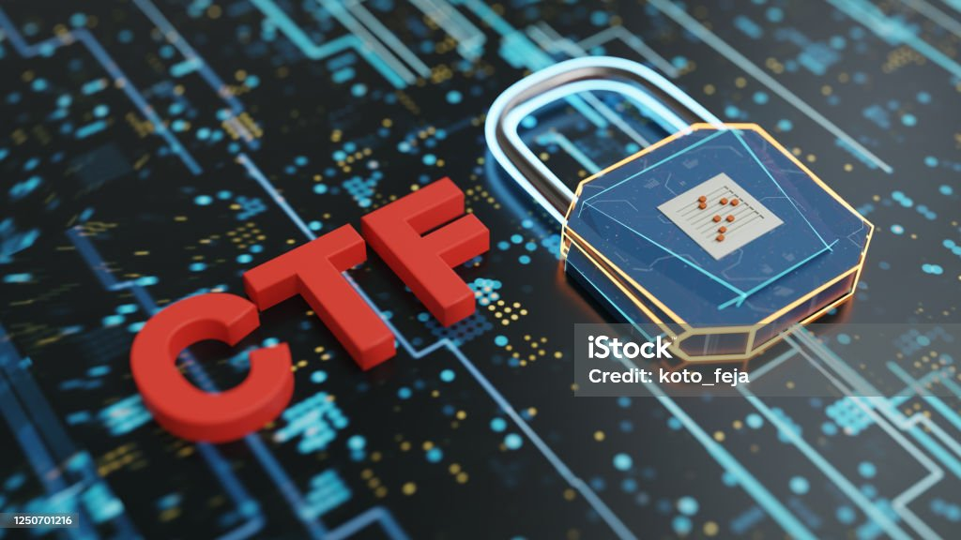
You now have two options!

Slide 25
Recommended Pico Challenges
Easy
Wireshark doo dooo do doo... + Wireshark twoo twooo two twoo...
Glory of the Garden
Medium
Sleuthkit Apprentice
WhitePages
Hard
investigation_encoded_1 + investigation_encoded_2
UnforgottenBits

Slide 26
Forensics Challenge
4 part challenge to test your skills in file/memory analysis.
Suitable for beginners!

Slide 27
Thank you for listening! Slides will be on the CyberSoc Server after this session.

